Slide 1
Time Series of Yearly Stock Prices of Company A and Forecasts in R

Slide 2
Class= “ts”
Univariate time series
ts has a time stamp. It shows the time at that particular value occurred..
Most time specific packages work with the class- time series.

Slide 3
We simulated 100 observations by first setting seed to reproduce the data.
Start= First available value
Frequency = number of observations per cycle
The data begins in the year 1955

Slide 4
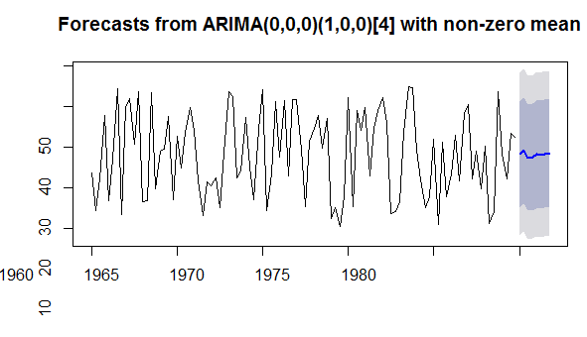
ARIMA MODEL

Slide 5
ARIMA
Stands for Autoregressive Integrated Moving Average
Modelling of univariate time series
Significant for analysis

Slide 6
Visualization of the Data
We apply the R base plot feature.
We also apply the ggplot2 for a more sophisticated solution.
The time stamp is on the x-axis.
The y-axis has the values of the data.
Here, they have the stock prices of the company A.

Slide 7
Arima model is the function we use here.
Forecast () : The forecast produces a forecast
Plot(): The plot function produces a plot
Autoplot function is the alternative to plot() in the ggplot function.
Ggseasonplot() gives a graph with seasonal variance.
Ggmonthplot() gives a graph with monthly variance.

Slide 8
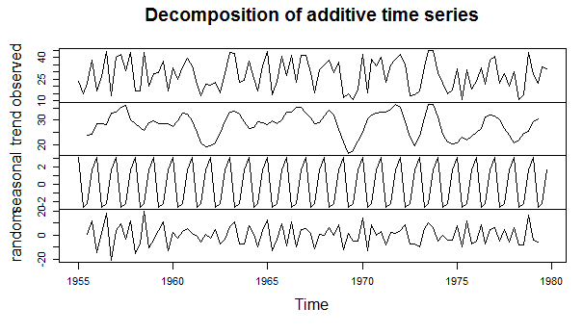
Decompose() gives the components, trend and seasonal of the dataset.

Slide 9
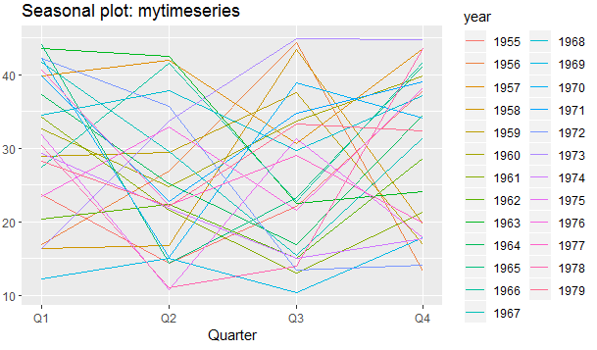
Seasonal Plot

Slide 10
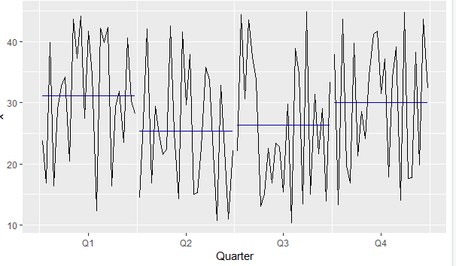
Monthly Plot

Slide 11
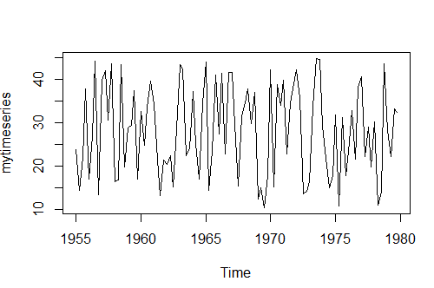

Slide 12
Length(): number of observations.
Tail(): the last output of the tail function is the last output of the data too.
Peaks occur every year in the plot.
Median is unaffected as 50% observations above and 50 % percent below the median.
Despite some short peaks, mean is pulled up due to the high peaks.

Slide 13
Random normally distributed dataset:
There is no clear trend.
In 1973 and the few subsequent years, there is a larger span than in the earlier years.
Mean stays the same
Variance looks constant.

Slide 14
The spikes and dips in the stock price are equi-distant to each other.

Slide 15
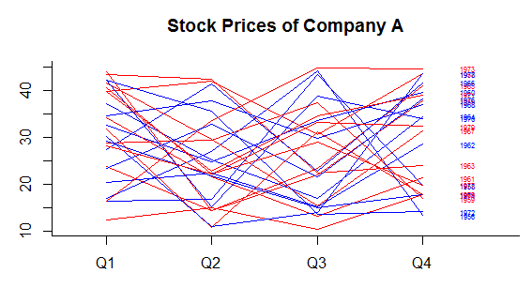
Line Graph of Season Plot

Slide 16
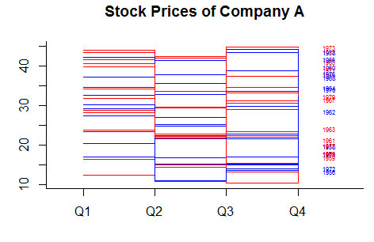

Slide 17
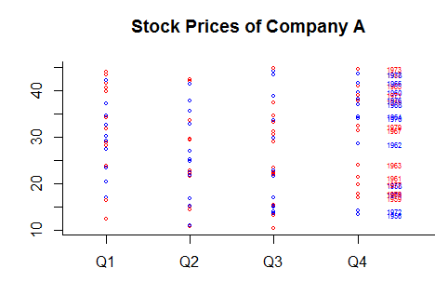

Slide 18
Simple: Methods of Forecasting
We forecasted 20 years into the future in the following three methods.
Fitted values are the forecasted values applied to the original dataset.
Naïve method: projects last observation carried forward method.
Random value most likely with a deviation of 1 -1<x<1

Slide 19
Average Method:
Calculates mean of the data, then uses that for forecasting.
Has the mean equal to 0.

Slide 20
Drift Method
Calculates the increase/decrease between the first and the last observation.
Then carries that into the future.

Slide 21
Comparing Forecasting Models:
-We need to see which model is best suited to the data.
-Then we see the difference between actual and forecasted results
-We use models which are on the same scale such as the RMSE, MAE, etc.

Slide 22
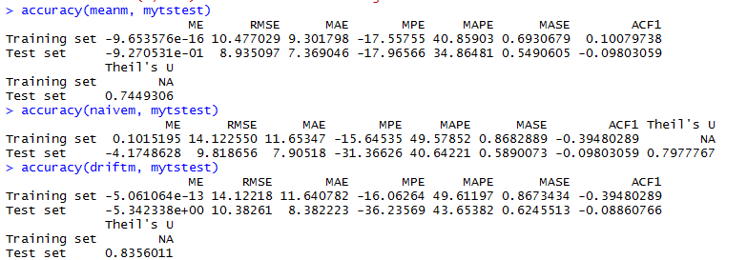

Slide 23
Mean method, comparing all three methods, performs best.
We get the smallest values for the ME(Mean Error), RMSE(Root Mean Squared Error), MAE(Mean Absolute Error), MPE(Mean Percentage Error), MAPE(Mean Absolute Percentage Error), MASE(Mean Absolute Scale Error) in all three methods(Naïve, Average and Drift Method) in the Average/Mean method.

Slide 24
Residuals
Residuals are the left-over data after we have made use of the fitted and the forecasted data.
Residuals can indicate the quality of the data.
They should have a mean of 0 and a variance which is constant.
Residuals need to show us randomness of the model.
Residuals should be normally distributed and uncorrelated.

Slide 25
The three simple models had residuals.
X(i)-fitted=residual
14.4-23.8=-9.4
We used the second value for the above variables in the drift model.
First position variance cannot be computed and is therefore NA-Not Any.

Slide 26
Histogram shows the drift method’s residuals
As is expected in a normal distribution they peak around 0 on the x-axis.
The diagram is positively skewed.

Slide 27
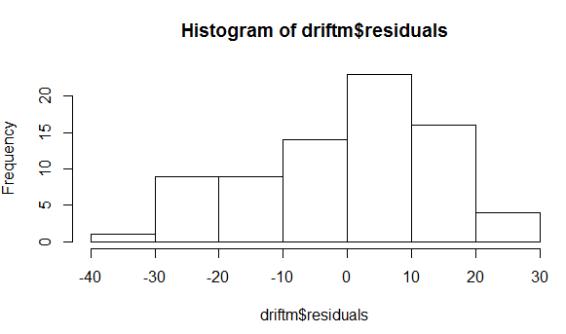

Slide 28
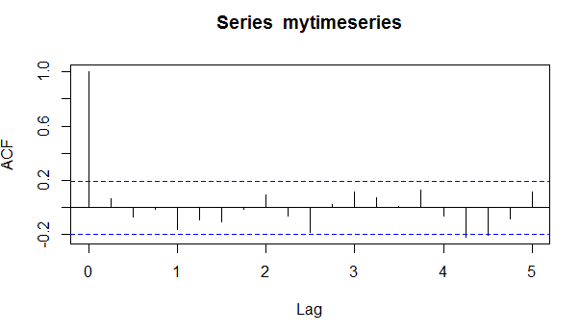

Slide 29
This diagram shows us that there are 3 bars outside the threshold.
2/20 bars on the x-axis (4.25, 4.5) show that there is autocorrelation.
There is information in the residuals.
If you want to reduce the bars, a transformation has to be run.

Slide 30
Stationarity
We check for the mean, variance and autocorrelation to be similar throughout the time series.
Most analysis needs stationary data
If there is no stationarity in the data, then we apply transformations or differencing.
We compare the null hypothesis showing non-stationarity with the alternative hypothesis showing stationarity.

Slide 31
-Adf.test(Augmented Dickey-Fuller Test)
Removes the autocorrelation
Tests for non-stationarity
METHOD 1
adf.test(mytimeseries)
METHOD 2: DIFFERENCE STATIONARITY
y<-diffinv(mytimeseries)
plot(y)
adf.test(y)

Slide 32
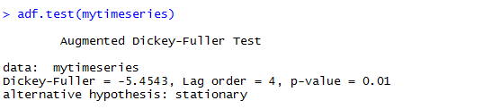
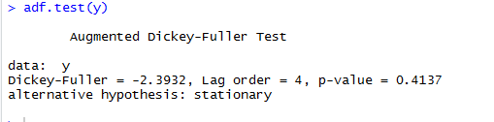
The p-value is less than 0.5 in both cases
This means we turn to the alternative hypothesis of stationarity.

Slide 33
Autocorrelation
It describes the correlation or lack thereof
It shows whether past observations influence the present ones.

Slide 34
Methods to Measure Autocorrelation
1. acf()
2. pacf()
3.Durbin-Watson test

Slide 35
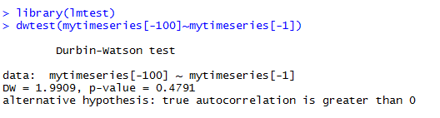
It is an autocorrelated dataset as p-value is above 0.

Slide 36
Simple Linear Models
Last observation carried forward model
Drift Model
Mean Model
For modeling data with no pattern
Benchmark for other models

Slide 37
Exponential Smoothing
Trend and seasonality are key determinants
Can put more weight on recent observations

Slide 38
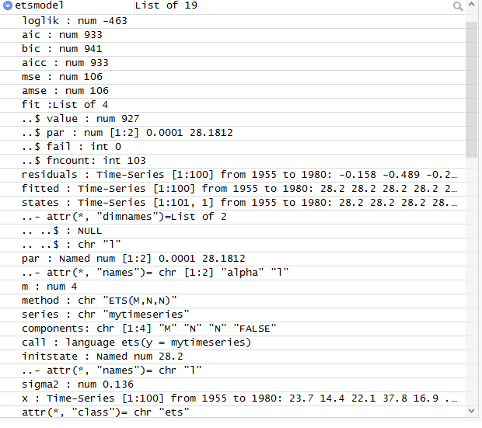

Slide 39
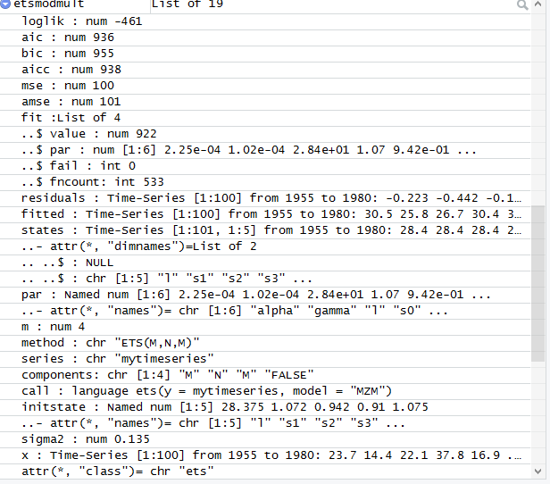

Slide 40
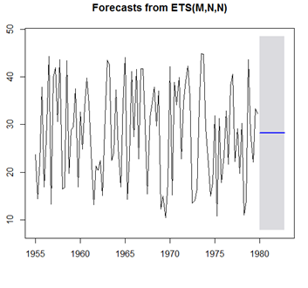

Slide 41
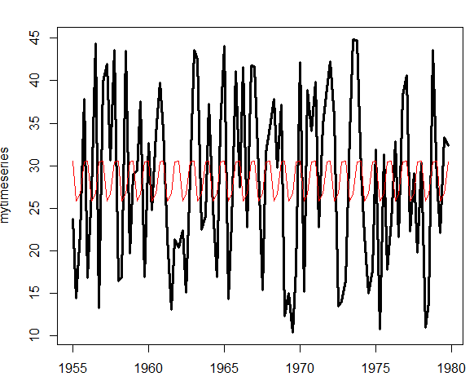

Slide 42
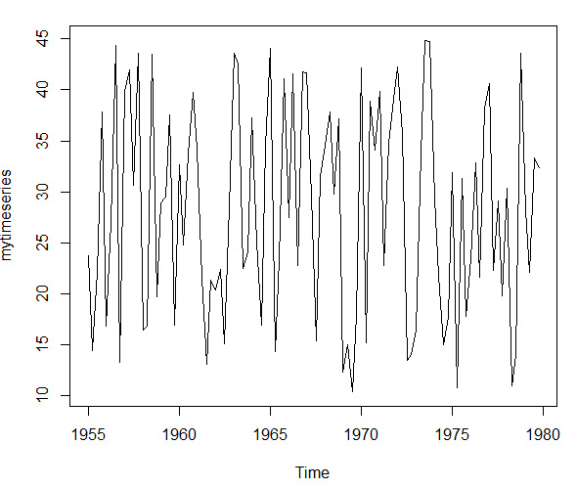
Simple Moving Average
The impact of very high and very low values is smoothed out in this method.

Slide 43
